Slide 1
Analysis of Covid-19 Impact on food insecurity

Slide 2
Questions Answered:
During COVID-19 changes:
In the consumption of food.
In the transportation methods to get food.
In the diet.
In the quality of food.
In the availability of food.
In the purchasing items.

Slide 3
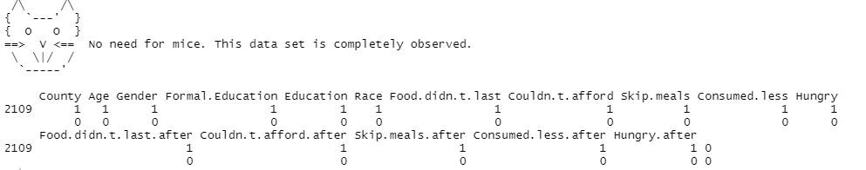

Data Cleaning : MiSSING values
Checking missing values in R

Slide 4
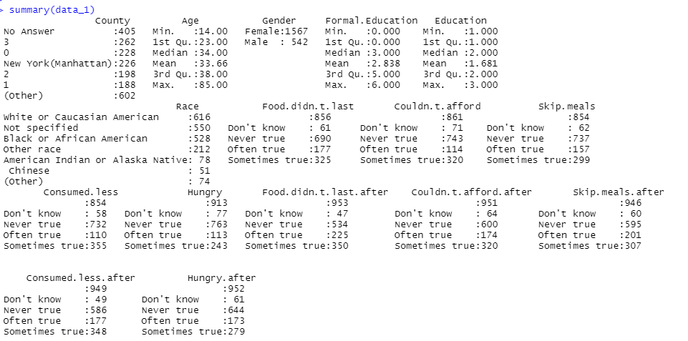
SUMMARY: Food Consumption

Slide 5
Visualization Chart

Slide 6
Consumption of FOod

Slide 7
Transportation
BEFORE CORONAVIRUS
AFTER CORONAVIRUS

Slide 8
DIET CHANGED

Slide 9
Access to Health CARE WAS A PROBLEM:
FEMALE
MALE

Slide 10
MEDICAL EXPENSE
FEMALE
MALE

Slide 11
POWER BI DASHBOARD

Slide 12
